Slide 1
CRIME IN NYC PRECINCTS
- Neil d’souza, Nikhil Kishore, Priya KHOKHER, SACHIN VERMA

Slide 2
INTRODUCTION
Crime is a issue in most metropolitan cities as it encroaches on the basic fundamental need for safety.
This project aimed to check if crime in different precincts of NYC is affected by various demographic factors and if so, which are the most influential ones.
We will briefly look at the data used and conclusions made after we performed our analysis.

Slide 3
DATA
Data | Definition | Granularity
NYC Precinct^{[1]} | NYC area divided according to Police Stations Jurisdiction | ShapeFile
Race, Income^{[2]} | Demographic data for NYC | Census Tract
Age, Gender^{[3]} | Demographic data | By Zip Code
Crime Statistics^{[4]} | Data about Crime in NYC | By Precinct
Schools^{[5]} | Point Locations of Schools in NYC | By Precinct

Slide 4
PREPARATION
Crime data from NYPD is available only at the precinct level, whereas US Census does not provide data at precinct level.
A spatial join of NYC Census tract shape file with NYC precinct shape file was performed. The join aggregated the statistics at precinct level.
Centroid (i.e. the intersection point of latitude and longitude of the Zip code area) was calculated for each of the Zip codes and then a spatial join performed using this centroid provided the desired aggregation of data set at precinct level (with least error).

Slide 5
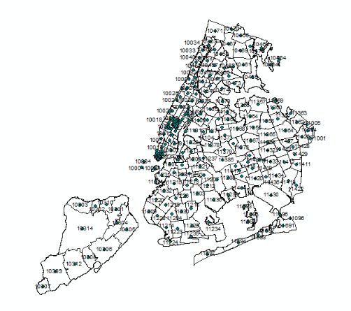
Zip Codes with centroids

Slide 6
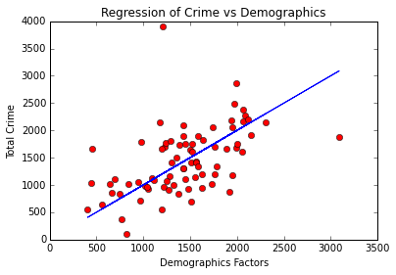
ANALYSIS
Multivariate regression was performed and showed a correlation between total crime and the regressors indicating that factors like age and median income have an impact (low p-values) but it was not possible to clearly interpret which regressors have a greater impact due to collinearity. The model did not perform so well on the validation set though slightly better than the training set (R-squared of 0.573).

Slide 7
ANALYSIS
Feature selection (forward-stepwise) was carried out on the regressors and it was found that precincts that have a greater population overall as well as a greater number of women, white people, Asians and Native Hawaiians have more crime.
The most probable reason for number of white people factoring in is that they comprise a majority of the total population in most precincts. It needs to be emphasized that the people falling under these categories need not be perpetrators of crime but also (and most probably) victims of crime.

Slide 8
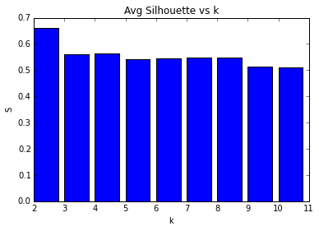
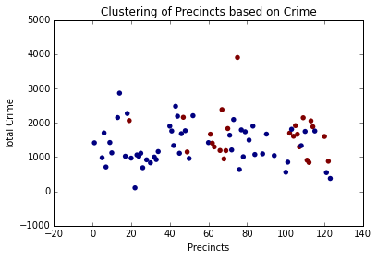
ANALYSIS
Outputs of K-means clustering:
Visually it was hard to see a clear distinction between the two clusters which means that no group of precincts displays characteristics that are distinctly similar.

Slide 9
CONCLUSION
Through the various analysis performed it can be concluded that crime is influenced by demographic factors and mainly by the total population in a precinct.
It is likely that precincts with a greater population of minorities will have more crime since opportunity for crime may be greater.
Despite the different locations of precincts, there seems to be no significantly similar patterns or characteristics among them to form separate groups/clusters.

Slide 10
THANK YOU QUESTIONS?

